Slide 1


Parkrun Teams
Developing a Parkrun web app enabling parkrunners to create running teams and challenge other teams over time and different courses.

Slide 2
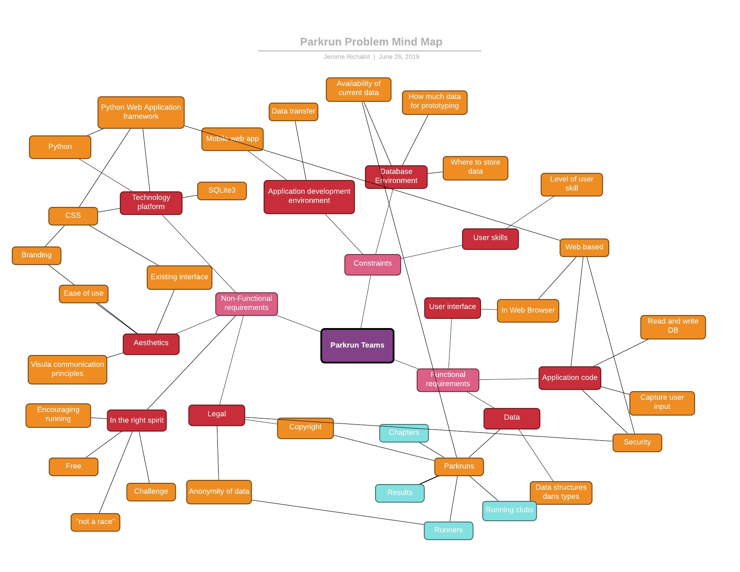
Problem Mindmap
Functional requirement
Allow parkrunners to create/delete teams
Allow park runners to list teams and join/leave teams
Allow parkrunners to check own team’s results and compare with other teams
Allow Parkrun organisers to retrieves statistics on teams and performances per team
Teams are casual groupings of runners
The creator of a team is automatically the team captain
Non-Functional requirement
Parkrunners must be able to create a team on the fly
Teams promote physical group activity
Teams must be “in the Parkrun spirit” i.e. not inherently competitive.
Challenges between teams are friendly challenges
The interface should reflect the Parkrun identity

Slide 3
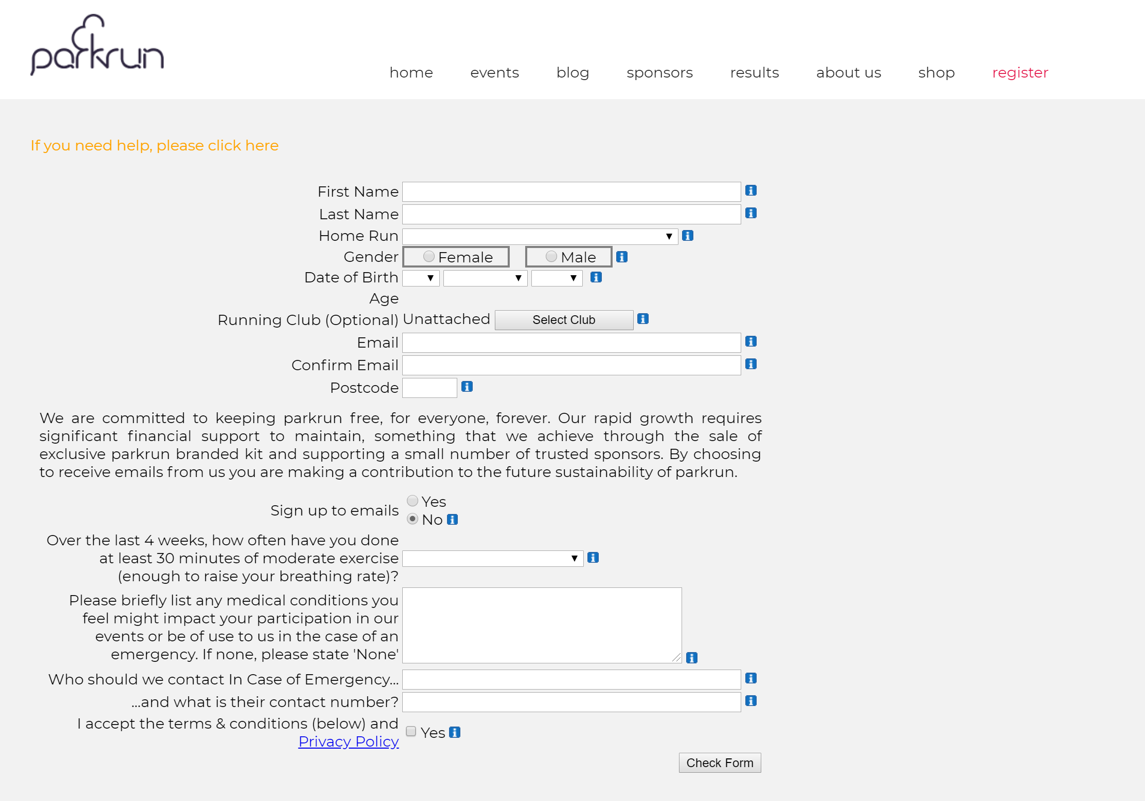
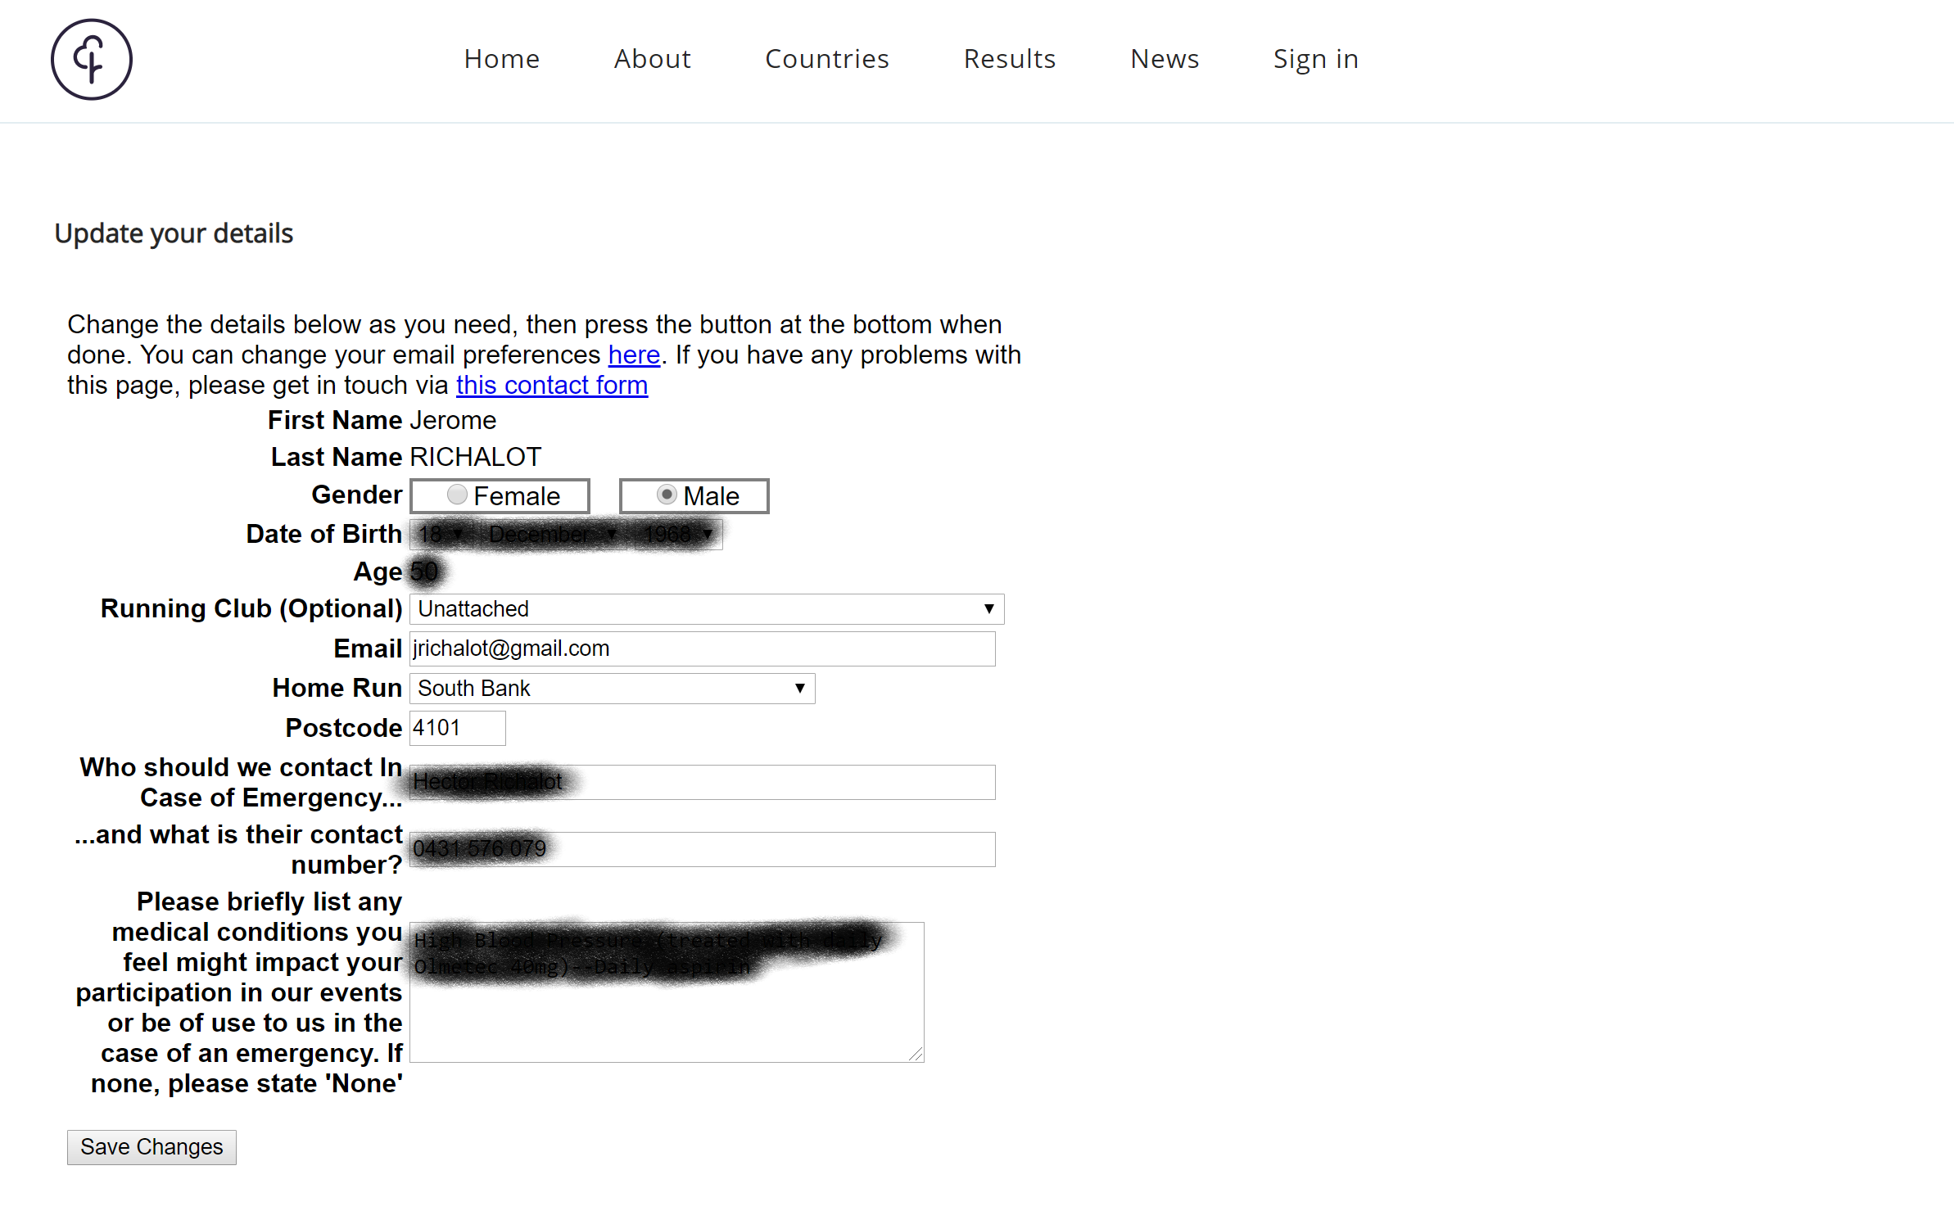
Exploring Parkrun
Observations on the registration page:
First name and last name, email and confirm email but no postal address
Home run to be selected from an existing list of parkrun chapters (compulsory)
Running Club to be selected from an existing list of running clubs (optional), default is “unattached”
Recent exercise to be selected from an existing list of recent exercise frequency
Notes:
The fields on the registration page will mostly be the ones in the Runner table
This suggests there needs to be a Chapters table. More information will need to be gathered from exploring a Chapter page.
This suggests there needs to be a Running Club table, “unattached” will be the default Running Club
What is the difference between a Running Club and a Team?
This suggests there needs to be a Recent exercise frequency table
Observations on the Runner profile page:
Some fields are not displayed in the profile
Confirm email
Sign up to emails
Accept Terms and conditions

Slide 4
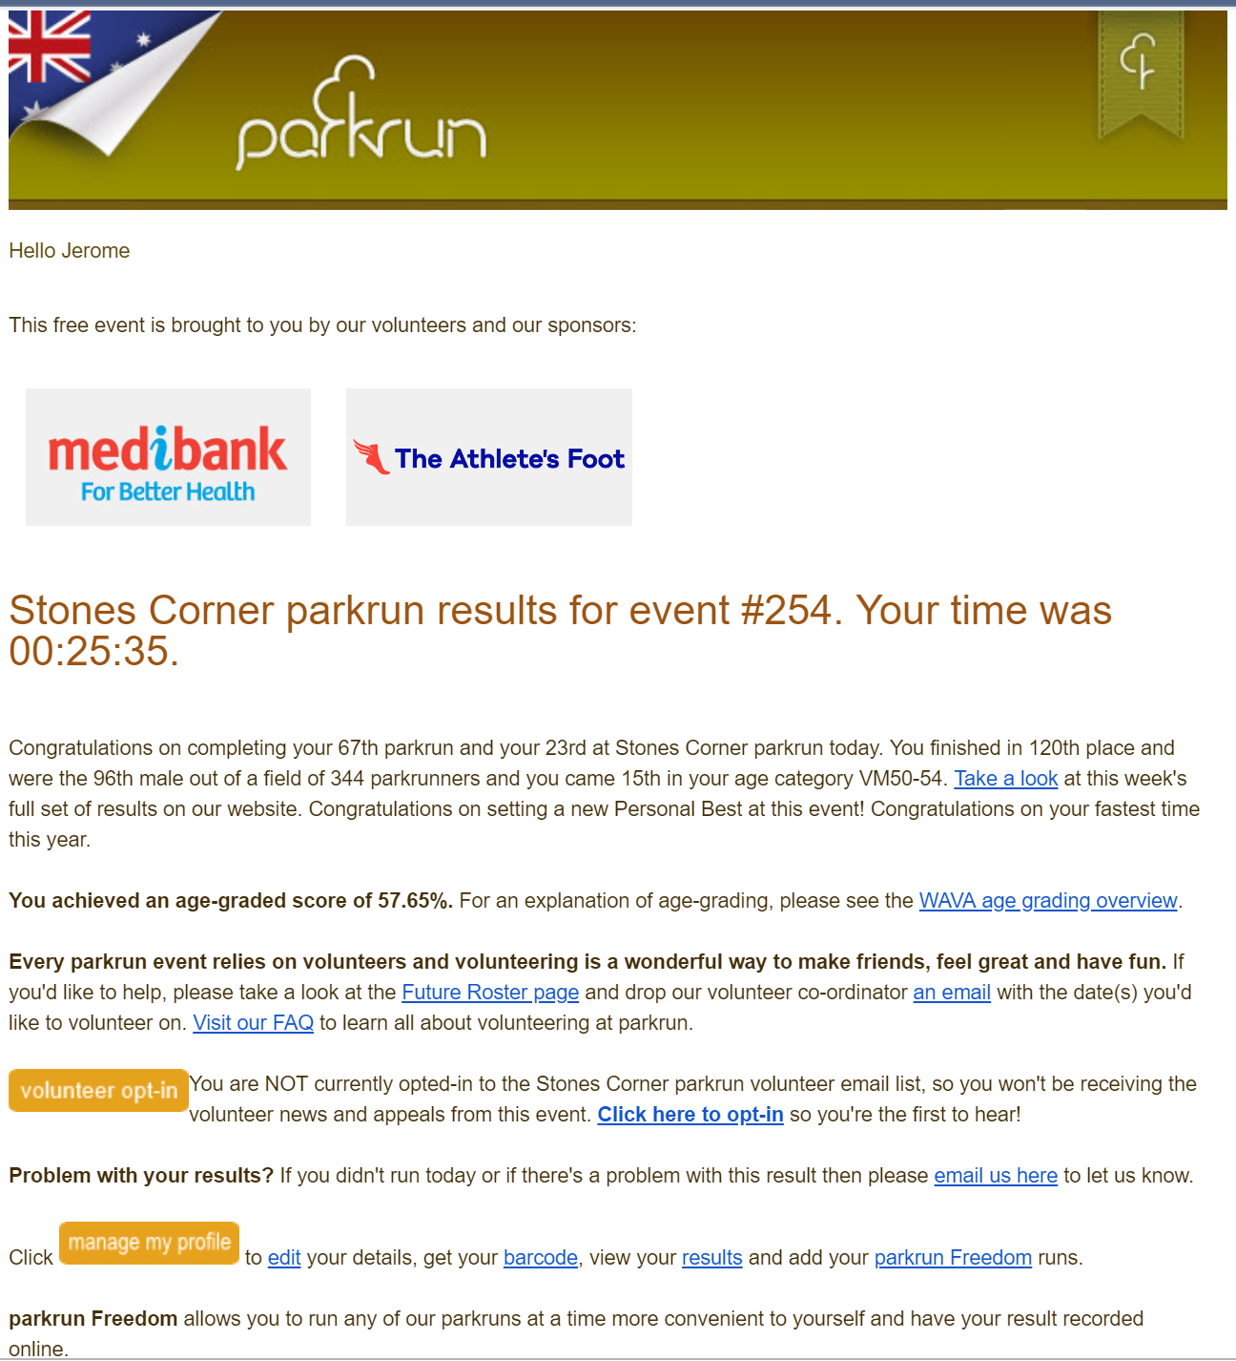
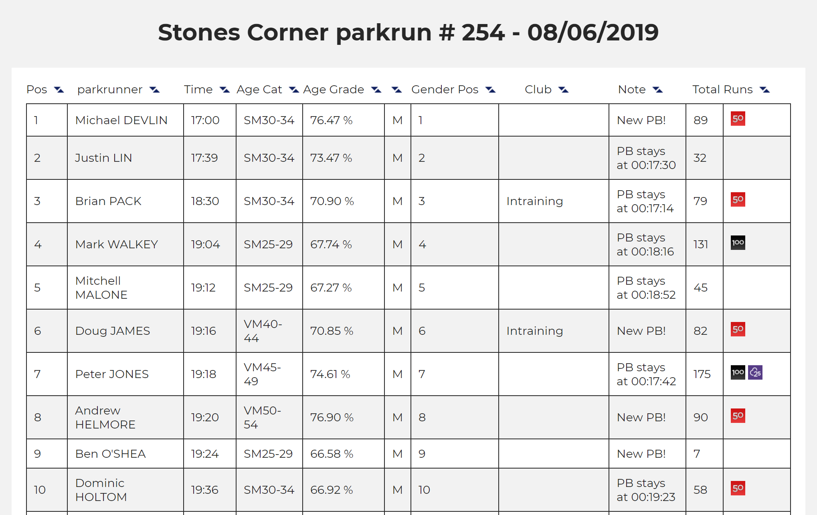
Exploring Parkrun
Observations on the result email
Individual results are given in minutes and seconds per Chapter per event
The overall number of events completed by a runner is tallied for all events and for events at a particular chapter
A result for a particular event is a runner, an event, a time, an overall position, an age category position, an age-grade score (percentage)
The email reveals the existence of a Roster for volunteers
The email provides a link to the runners past results and statistics
Observation on the event results
Confirms observation of individual results
Shows parkrun 50/100 club badges and 25V badge
An event does not exist without results as there is no pre-registration. Taking part in an event is effectively recording a time for that event. If no-one turned up for an event, the event would not exist. So the event page of the results’ page are effectively the same thing

Slide 5
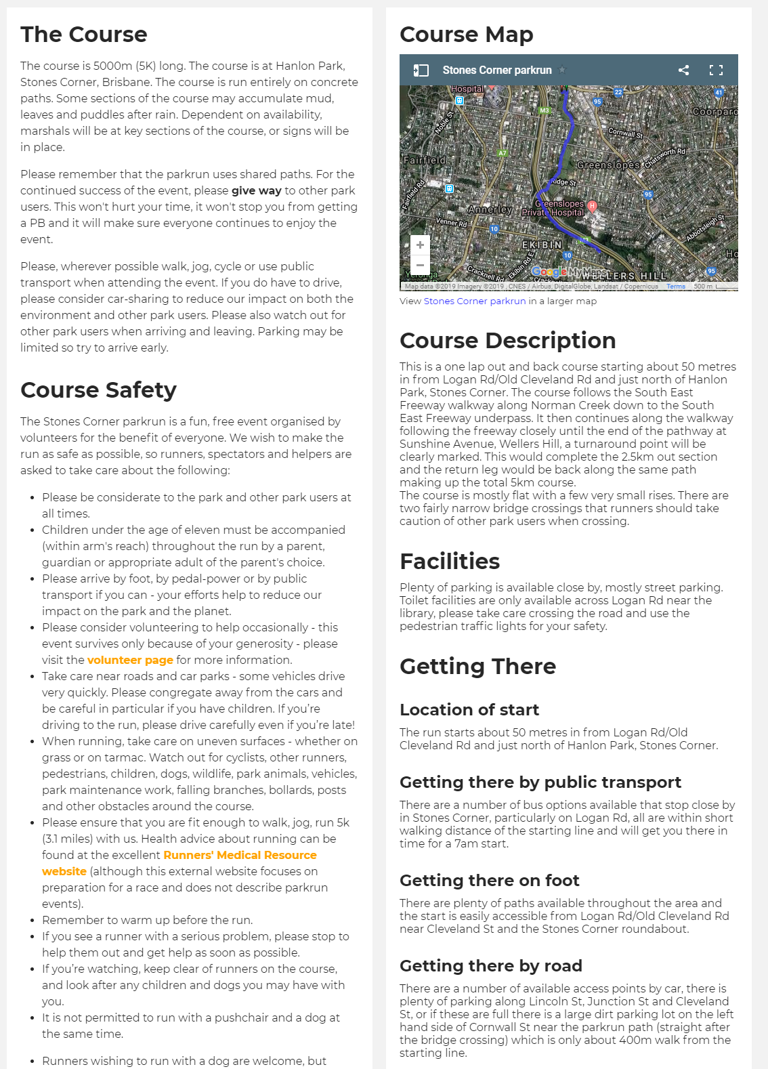
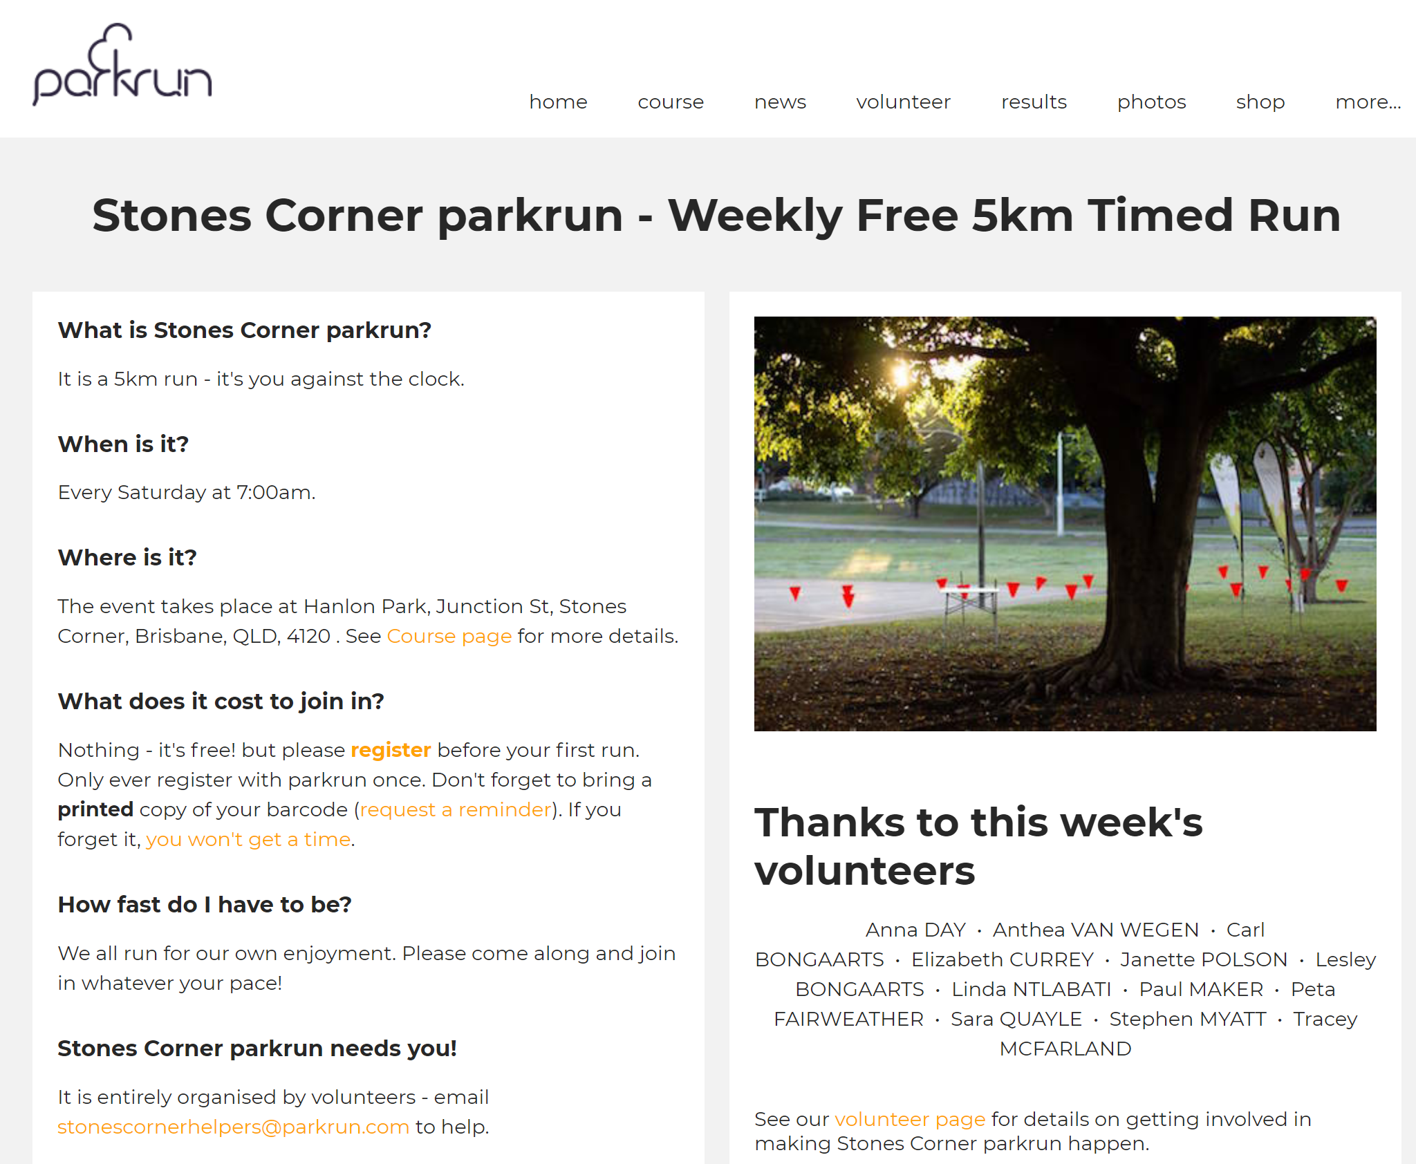
Exploring Parkrun
Notes on the Chapter page:
A Chapter has a name, an address, a photo, an email address and a course
Notes on the course page:
Some information on the course page is generic and does not need to be stored in the database. e.g. Course safety
A course has a map, a description, facilities, a location of start, a getting there by public transport, getting there on foot and getting there by road
Since a chapter has one course and one course can only be run by a chapter, the course information can be in the Chapter table.

Slide 6
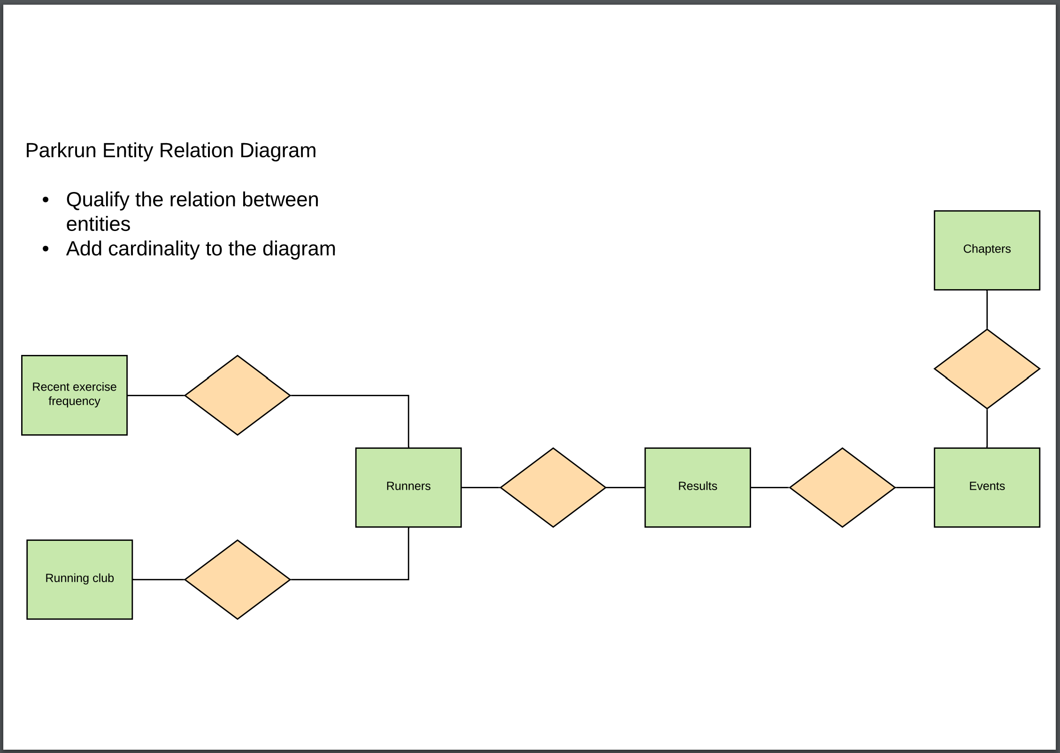

Entity Relation Diagrams
Entity Relation Diagrams map details of connections between major key data and their associated attributes
Complete the following ERD

Slide 7
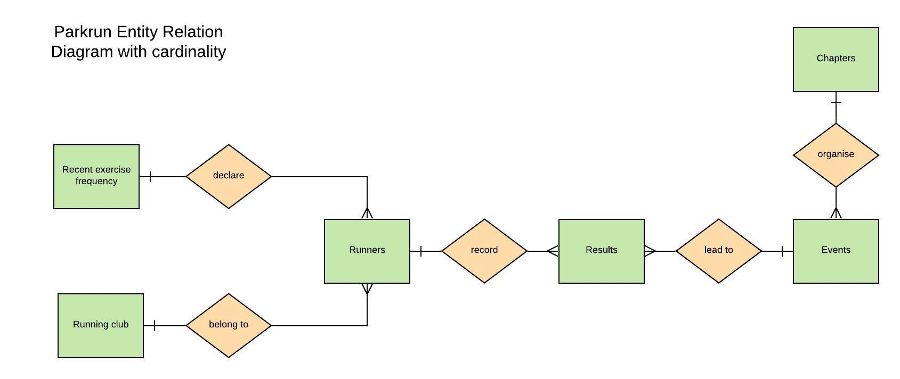
Developing Parkrun

Slide 8
Entity Relation Diagram
Reproduce the ERD in Lucidchart.com adding attributes to entities

Slide 9
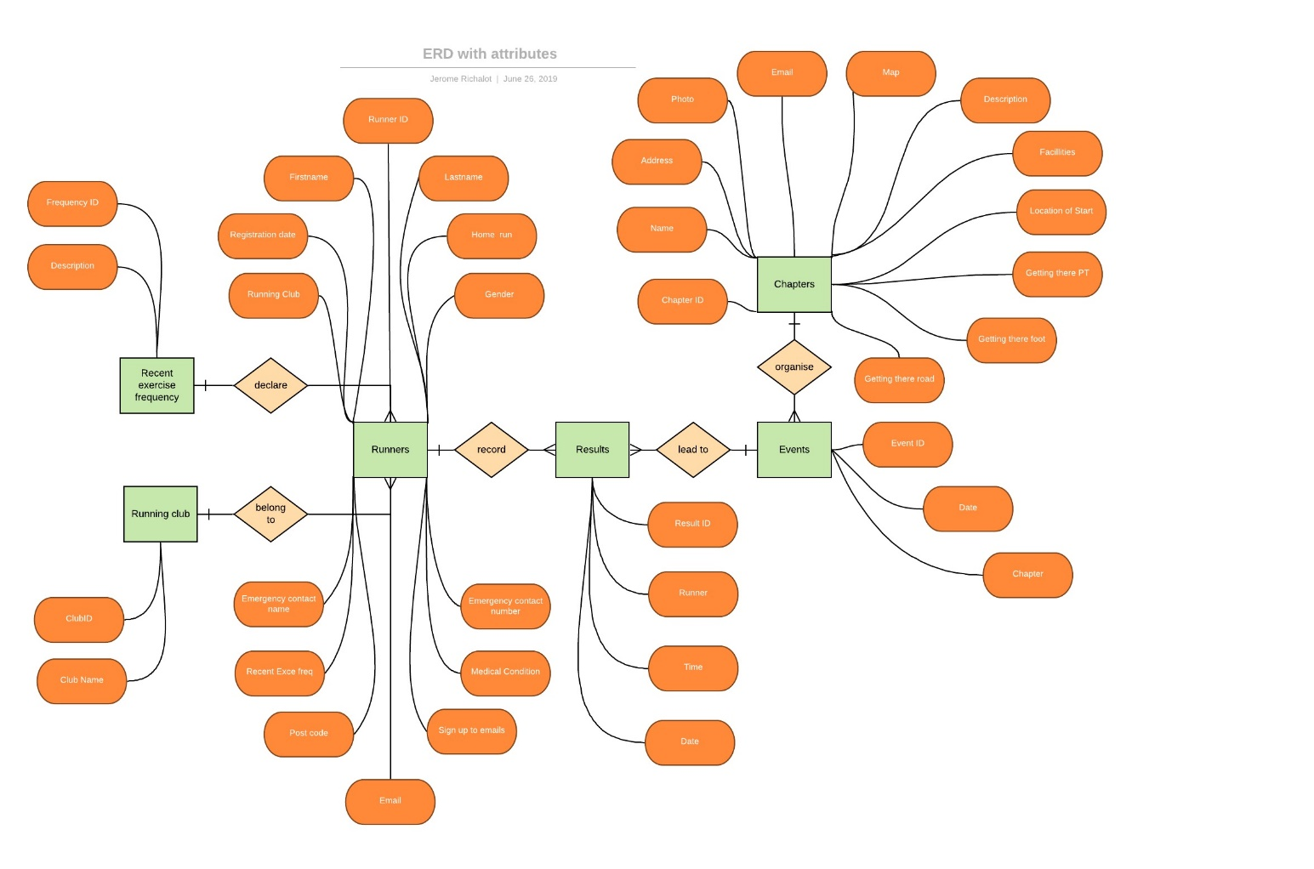
Entity Relation Diagram

Slide 10
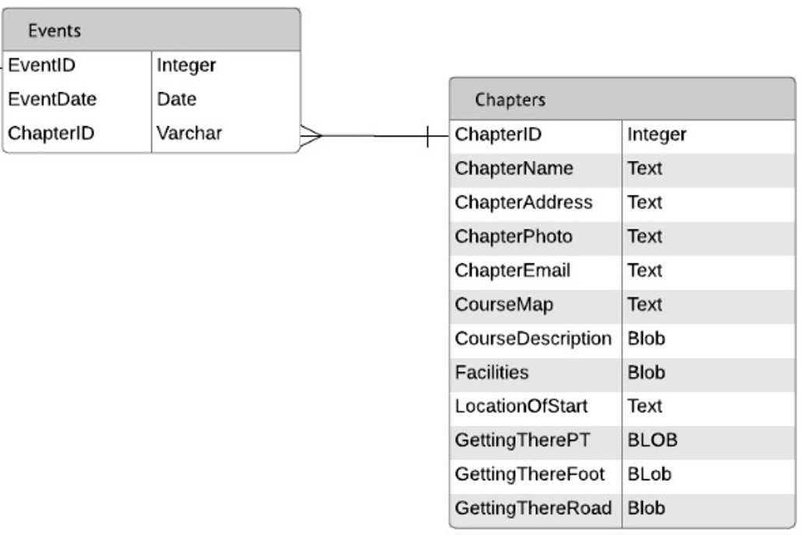
Entity Relation Diagram
Based on this ERD, and the “starter”, in Lucidchart.com develop the Database ERD

Slide 11
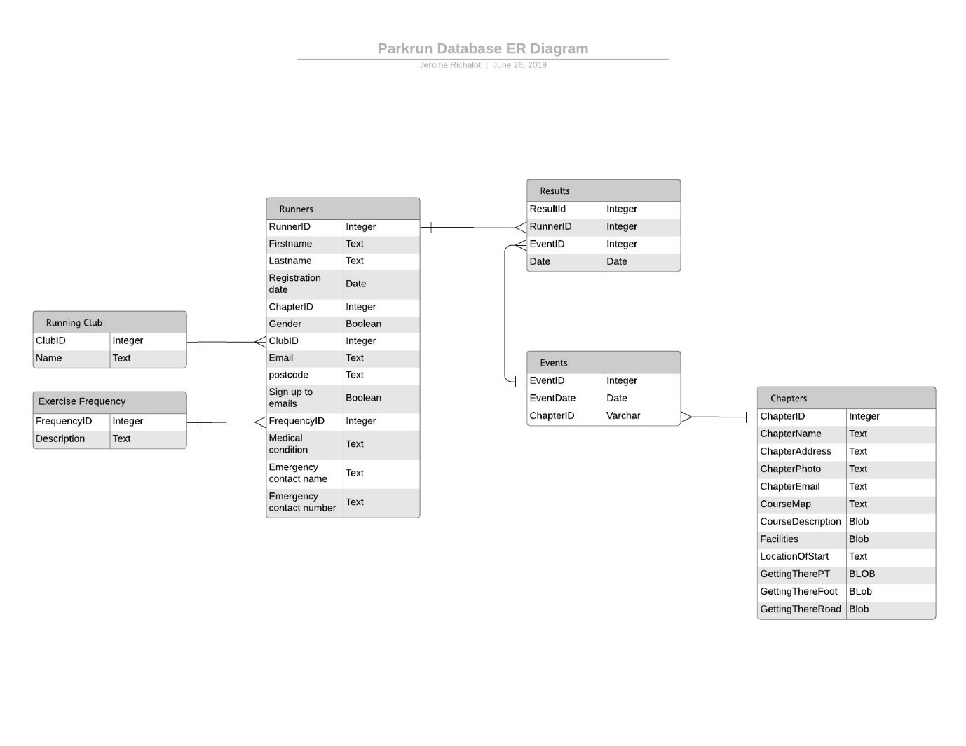
Database Entity Relation Diagram

Slide 12
Creating the Database
Run the following code from the Python command line. It will only be executed once and therefore does not need to be saved.
#import the sqlite3 module
import sqlite3
#create a connection (a connection object) to a non-existing db #creates that db
myConn = sqlite3.connect("parkrun_db.db")
If you do not get an error upon executing the file, you can assume parkrun_db.db has been created
If you encounter an error, investigate.
Potential errors would be:
spelling mistake of function name connect()
absence of quotes around parameter of connect()
trying to write to read-only volume/dir
Note that omitting the .db file extension will mean that your db may not be recognised as such.

Slide 13


Creating database tables
Create tables programmatically from Python to ensure regularity in the process (naming of tables, fields, attributes, etc.
Consider the CREATE TABLE SQL Statement
CREATE TABLE "TableName" ( "Field1" PARAMETERS OF FIELD 1, "Field2" PARAMETERS OF FIELD, "Fieldn" PARAMETERS OF FIELD n)
The statement has a constant part (the command itself) and two variable parts (The name of the table oand the fieldname + parameters part n times.
CREATE TABLE "TableName" ( "Field1" PARAMETERS OF FIELD 1, "Field2" PARAMETERS OF FIELD, "Fieldn" PARAMETERS OF FIELD n)
The fields names part can be broken into two parts:
the field name part
the field parameters part
The variable types best suited for the structure described above are:
a string for the table name part
a dictionary for the fields names part. In that dictionary, the field name is the key and the field parameters are the value for that key.

Slide 14
Creating database tables
The IPO table corresponding to that process is as follows
INPUT | PROCESS | OUTPUT
Table name as string Table fields and corresponding parameters as dictionary | CREATE an SQLStatement variable of String type and ASSIGN the initial constant part of the SQL CREATE Statement. APPEND the string passed to the end of the SQLStatement variable including SQL syntax LOOP through the keys of the dictionary passed and corresponding keys APPEND each key, value pair to the SQLStatement variable including SQL syntax RETURN the SQL-ready SQLStatement | SQL-ready CREATE TABLE Statement

Slide 15
Creating database tables
Pseudo code for the function to create database tables could be as follows
CREATE a dictionary variable and instantiate it with as many key/value pair as you have fields in the table you are creating. Each key is a field name and each value the SQL parameters of that field
CREATE a string variable and instantiate it with the constant part of the SQL CREATE TABLE Statement
CREATE a function that takes a sting (the table name) and a dictionary (the fields and field parameters) as parameters
CONCATENATE the table name passed to the function to the sting containing the constant part of the SQL CREATE TABLE Statement
LOOP Through the dictionary passed to the function and CONCATENATE the field name (key) and the field parameters (value) to the sting containing the constant part of the SQL CREATE TABLE Statement and the table name
When concatenating, insert punctuation between function and table name fields, as well as between fields, as needed.
You may need to trim the final statement to make it fully SQL compliant.

Slide 16
Creating database tables
Write a python function that creates database tables programmatically.
Refer to the following codthe pseud code in the previous slide
Consider e as help
Looping through the keys of a dictionary
For x in thisdict:
print(x)
Looping through the values of a dictionary
For x in thisdict:
print(thisdict[x])
Right-trimming a string
>>>a = “a string”
>>>print a[:-1]
a strin
All code examples from https://www.w3schools.com

Slide 17
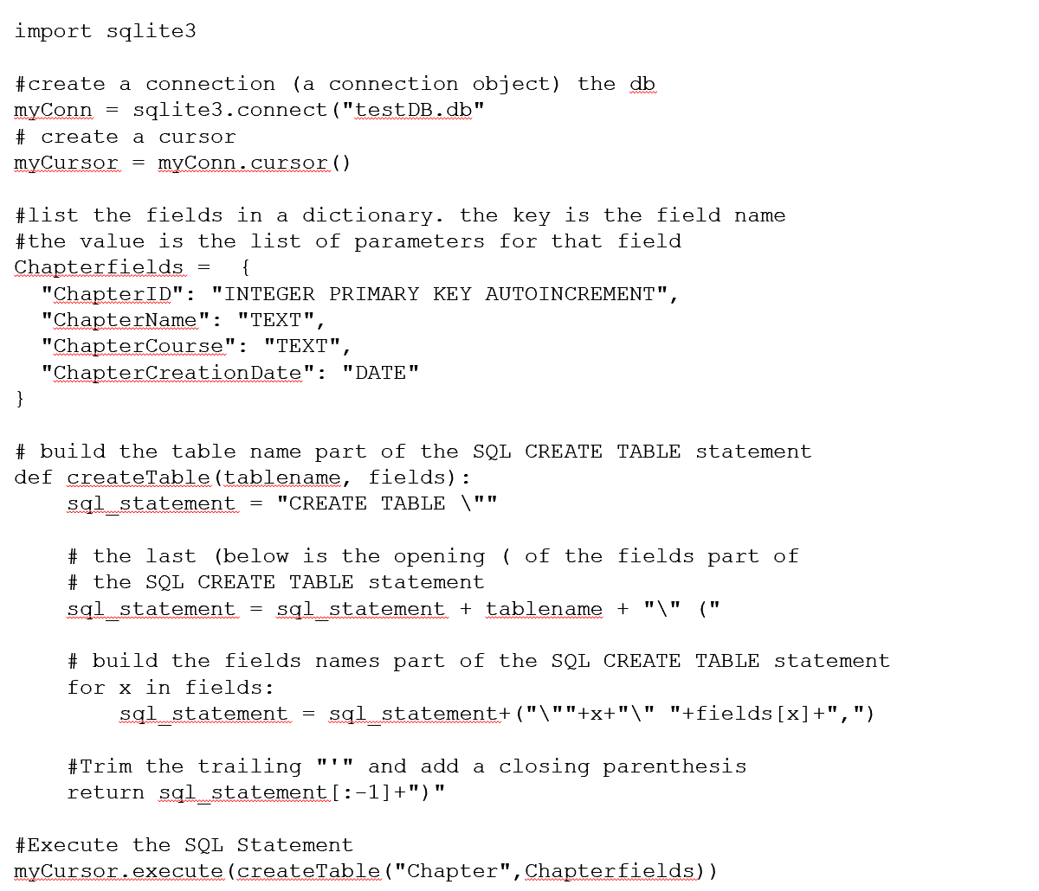
Creating database tables

Slide 18

Populating database tables
Data:
Use a representative sample (big enough, with enough “special cases”)
The least you handle/manipulate/edit data the better (less risk of error)
Some tables will be populated tables by importing .csv files
Some tables will be populated by importing from .csv files
Use real data (Chapters, Events, RecentExerciseFrequency, RunnningClubs, Runners)
chapters.csv (provided)
Data was cut and pasted into Excel and a .csv file exported from the following Parkruns:
South Banks
Stones Corner
St Lucia
Mudgeeraba
Varsity Lakes
RecentExerciseFrequency.csv (provided)
Data was manually entered into Excel and a .csv file exported from the Recent exercise frequency dropdown list of the Parkrun registration page.

Slide 19


An important word on database security
So far we have built queries as strings and passed them directly to the execute() function of the cursor.
Now that we are importing external data into the database and for later use (when users interact with the database), we need to protect ourselves against SQL injections.
What applies to PHP + SQLServer applies to Python + SQLite3
The execute() function of the cursor will refuse to execute several commands…
… there is an executemany() function (which we will use very soon) !

Slide 20
Prepared statements – How to
DO NOT DO THIS!
user_firstname = input("enter your firstname")
user_lastname = input("enter your lastname")
query = "INSERT INTO Students(FirstName, LastName) VALUES (\""+ user_firstname +"\",\"" + user_lastname +"\")"
myCursor.execute(query)
myConn.commit()
The user input (understand “whatever the user inputs”) is appended as such to the query
Use positional parameters
user_firstname = input("enter your firstname")
user_lastname = input("enter your lastname")
query = "INSERT INTO Students(FirstName, LastName) VALUES (?,?)"
pos_param = (user_firstname, user_lastname)
myCursor.execute(query,pos_param)
myConn.commit()
The positional parameters are passed as a tuple. The first value in the tuple replaces the first positional parameter, the second value in the tuple replaces the first positional parameter, the second positional parameter, etc.
Tuples are immutable
Pass (“Value1”,) if you’re only passing one value

Slide 21
Prepared statements – How to
Use named parameters for longer lists of fields
query = "INSERT INTO Students (FirstName, LastName) VALUES (:firstname, :lastname)"
named_param = {'firstname':user_firstname ,'lastname':user_lastname}
myCursor.execute(query, named_param)
myConn.commit()
Named parameters are prepended with “:” in the SQL query
Named parameters are passed as a dictionary in which the key is the name of the parameter (without the prepended “:”) and the corresponding value is the string replacing the parameter in the SQL Statement

Slide 22
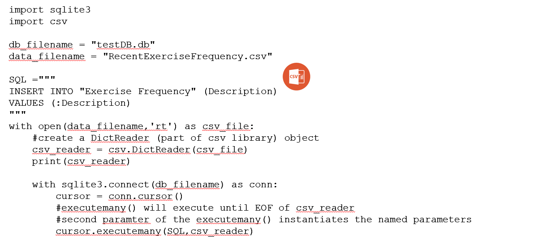
Importing a .csv into a database table
Adapt the code from the previous slide to import RecentExerciseFrenquency.csv into the Exercise Frequency table
All parameters (referred to as “bindings” in error messages) must be provided with a value in the csv use "None" if data is not available
Do not import any value for the primary key as it is auto-incremented in the DB table
The “with” statement in Python enables us to open a .csv file as a file object AND make sure it is closed when we have finished
The DictReader object of the csv module enables us to read data in dictionary form
The “with” statement to open the DB also ensures it is closed upon completion (and changes are committed)
We use the executemany() function of the cursor to read and import the csv line per line

Slide 23
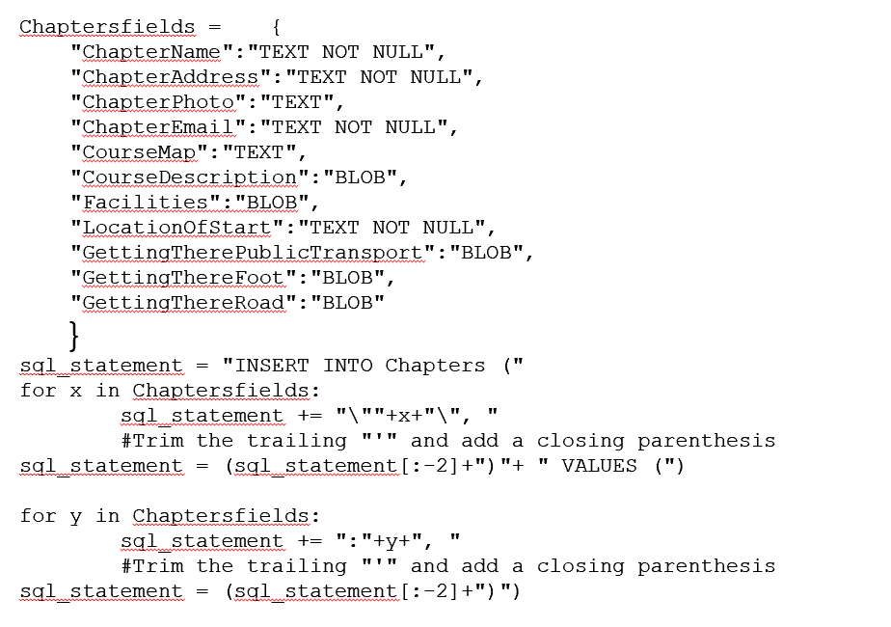
Importing a .csv into a database table
Use the code below to import chapters.csv into the Chapters table
To avoid errors, generate the SQL Statement including named placeholders programmatically using (cut and paste) the same dictionary you used to create the Chapters table
Remember you do not need to include the PK in the INSERT statement as it is Auto-incremented

Slide 24
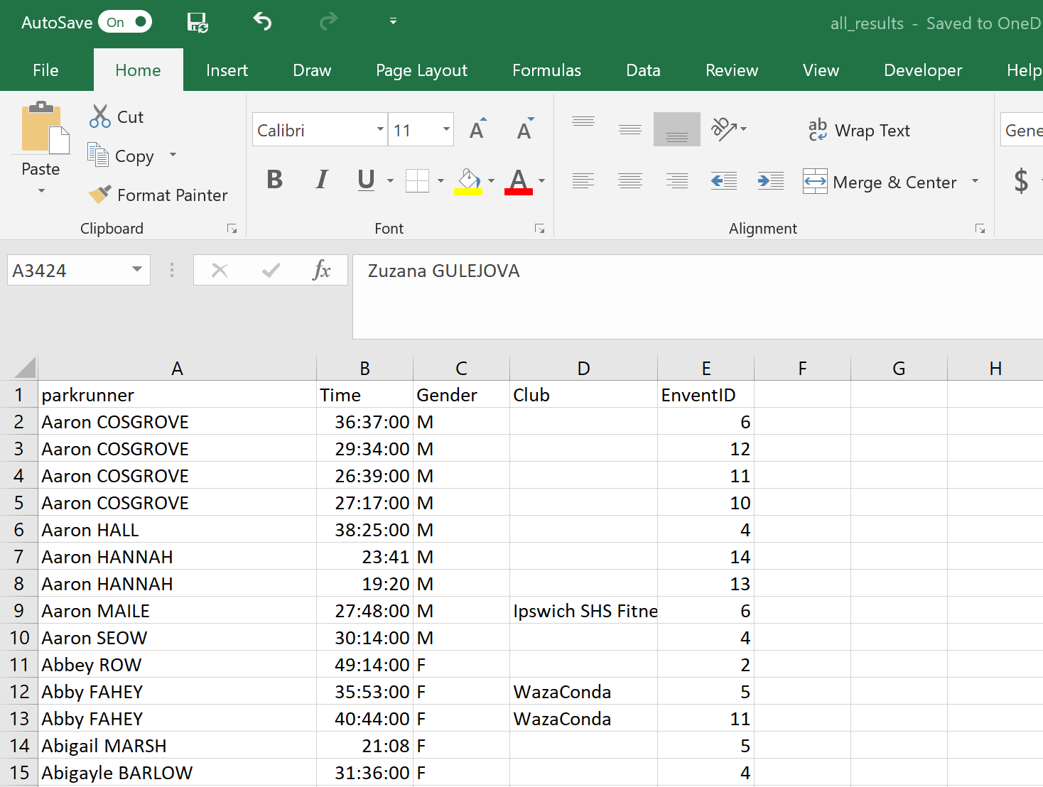
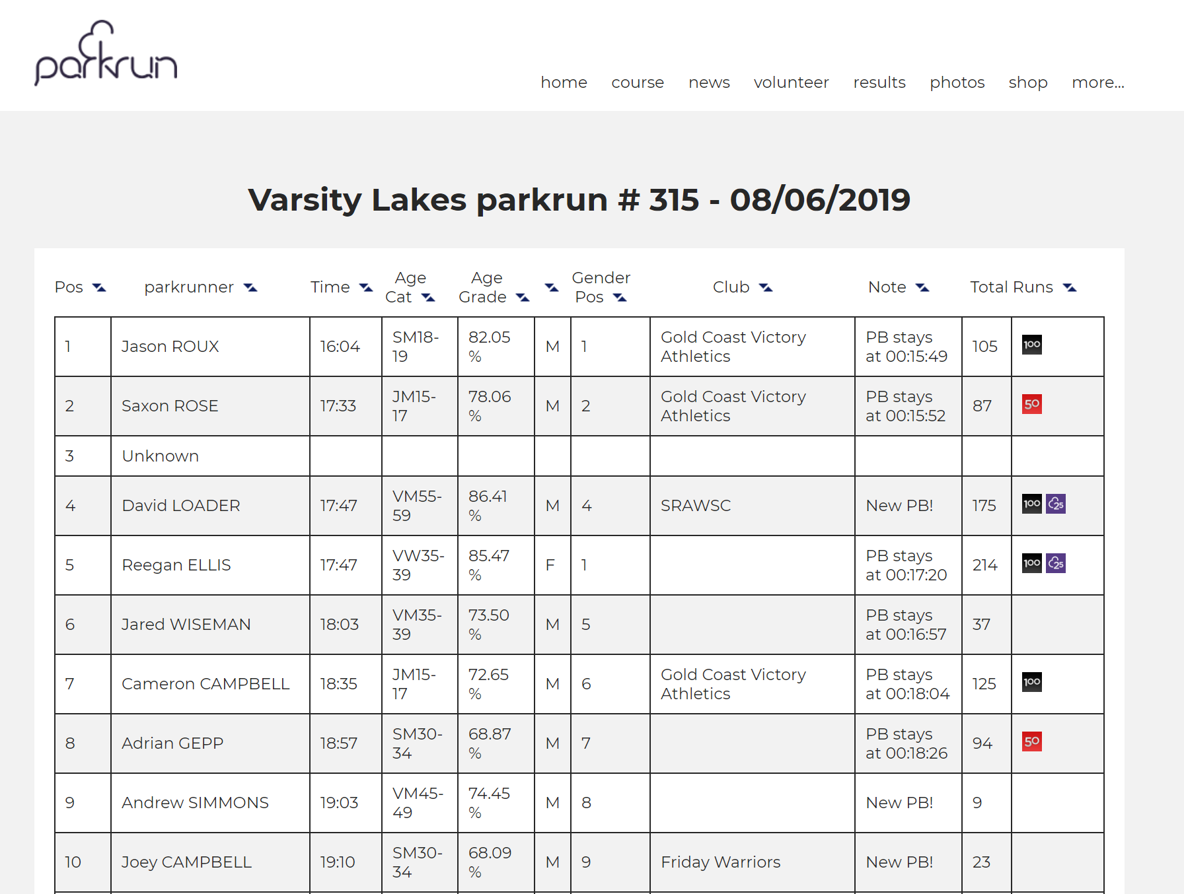
Collecting Data and Normalising Data Tables
Data on events, runners and running club data is available but will need to be normalised i.e. reorganised to be useable in a relational format.
All_results.csv comprises (15 events, 3 per chapter, consecutives weeks 08/06 to 22/06 except Southbank, 01/06 to 15/05, 22/06 having been cancelled)
Data was copied and pasted from events pages
Fields deemed irrelevent were deleted
Event ID were added manually
3423 entries

Slide 25
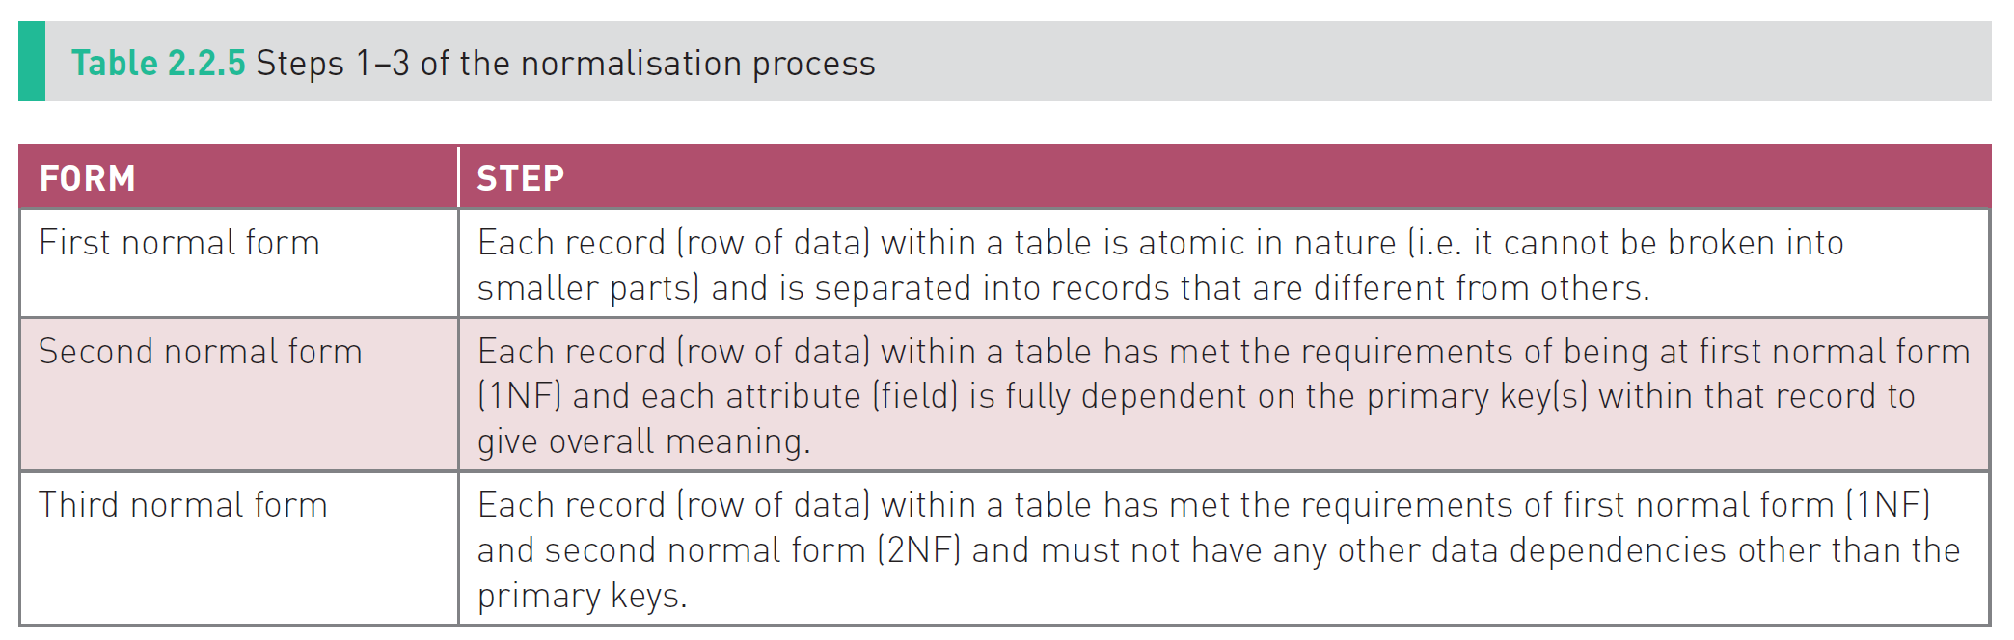

Normalisation process
1NF to 6NF

Slide 26
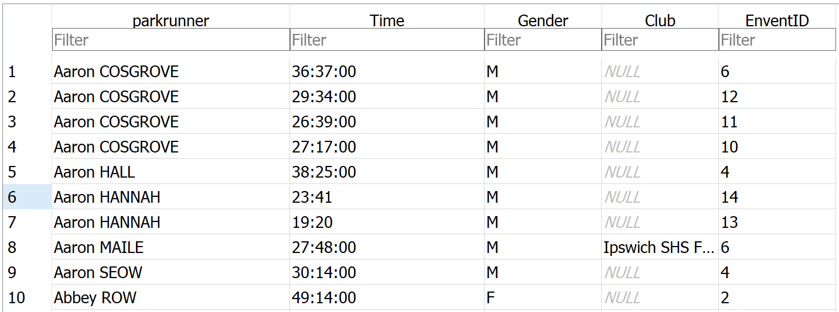







1NF
“Each record is atomic in nature.”

Slide 27





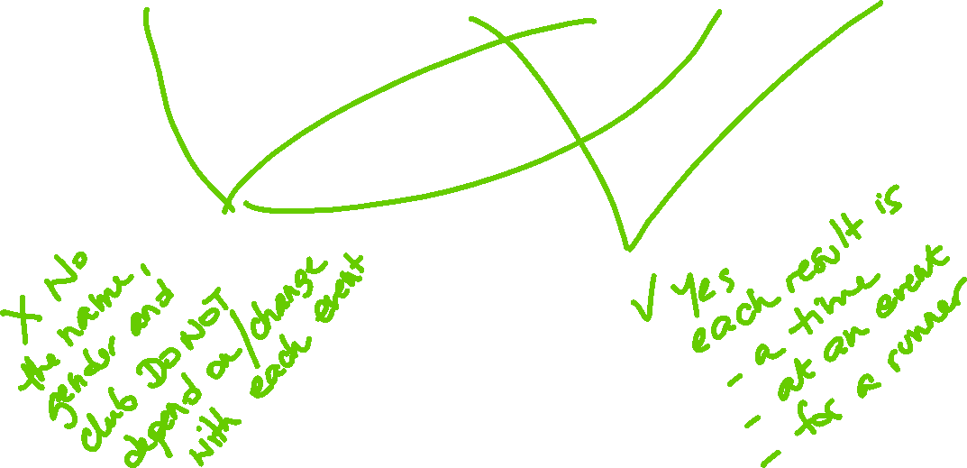
2NF
All records have met 1NF
“Data must be fully dependent on the primary key within each record to give overall meaning” i.e. Non primary attributes are fully dependent on the primary key to give overall meaning (Note we have not added a ResultID yet. Assume the primary key IS ResultID)

Slide 28
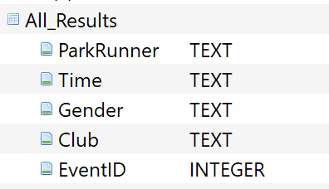
2NF
All records have met 1NF
“Data must be fully dependent on the primary key within each record to give overall meaning” i.e. Non primary attributes are fully dependent on the primary key to give overall meaning (Note we have not added a ResultID yet. Assume the primary key IS ResultID)
Solution: create a Running clubs table and a Runners table.
Import the all_results.csv into a table
Create an All_Result Table as follows:
Attach the all_results.db database provided as “results”
Run the following query INSERT INTO All_Results SELECT * FROM results.all_results;

Slide 29
2NF
All records have met 1NF
“Data must be fully dependent on the primary key within each record to give overall meaning” i.e. Non primary attributes are fully dependent on the primary key to give overall meaning (Note we have not added a ResultID yet. Assume the primary key IS ResultID)
Solution: create a Running clubs table and a Runners table.
Create a Clubs table programmatically as follows (use the .py function developed earlier in the unit)
CREATE TABLE "Clubs" (
"ClubID" INTEGER PRIMARY KEY AUTOINCREMENT,
"ClubName“ TEXT
);
Run a query on the All_results table to extract all Running Clubs as unique/distinct values and import them into the Running Club table. Wrap the following SQL query in your code
INSERT INTO Clubs (ClubName) SELECT DISTINCT Club FROM all_results
The primary key is auto-incremented and will be added upon INSERT.
Repeat the process for runners

Slide 30
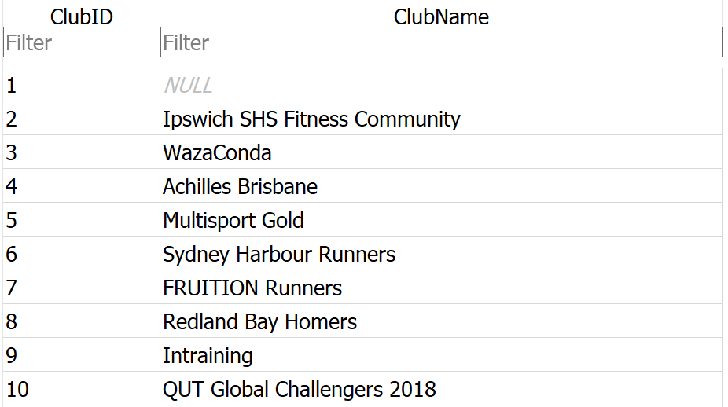
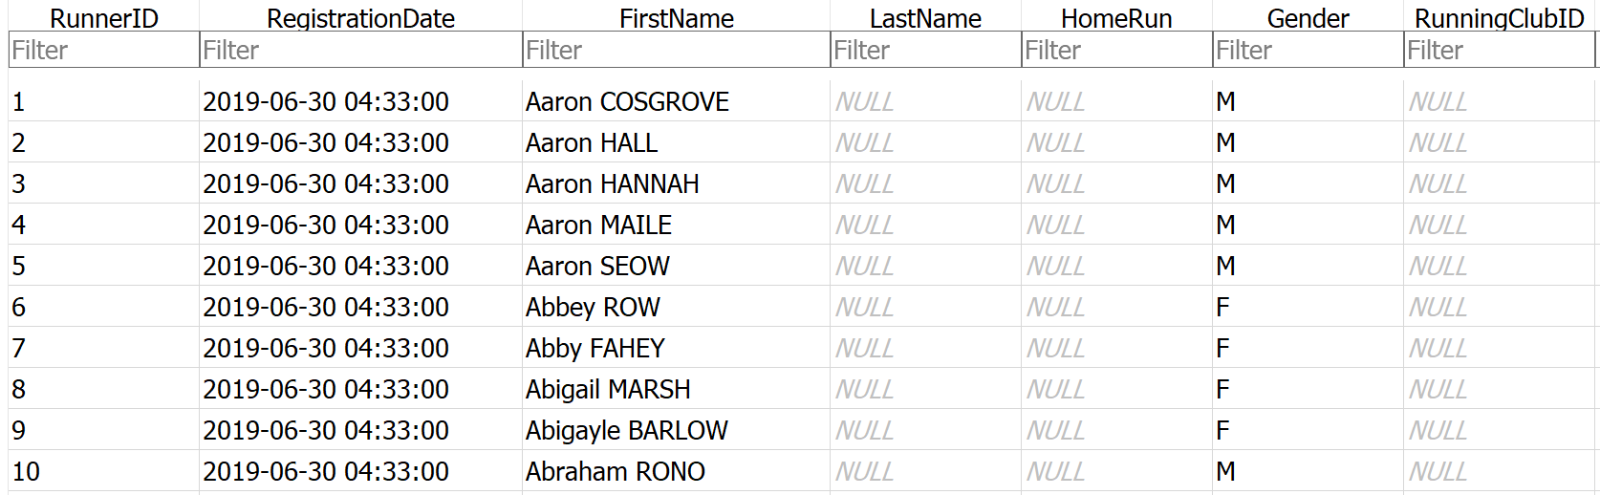




2NF Linking Tables

Slide 31


Linking Tables
Linking tables means referencing the primary key in the table on the “one” side of the relation with the corresponding foreign key in the table on the “many” side of the relation.
“One runner has many results”

Slide 32
Linking Tables
Instead of modifying the All Results table and replacing Names of runners with their ID from the runners table, we are going to write a new Results table pulling information from the Runners table (The runners ID) and from the Results table (time and eventID). This enables you to start afresh if you get it wrong.
Create a Results table programmatically as follows (use the .py function developed earlier in the unit)
CREATE TABLE “Results" (
“ResultID" INTEGER PRIMARY KEY AUTOINCREMENT,
“RunnerID”:”INTEGER”,
“Time” TEXT,
“EventID” INTEGER
);
Pseudo code:
FOR EACH Runner record in the Runners table
FOR EACH Result record in the All Results table
IF the Runner name in the Runners Table is the same as the Runner name in the Results table
WRITE the RunnerID from the Runners Table, the Time from the Results table and the Event ID from the Results table

Slide 33
Linking Tables
import sqlite3 #create a connection (a connection object) the db myConn = sqlite3.connect("./testDB.db") """ create a cursor for all distinct runners create a list of tuples each tuple is a record in Runners the table each tuple item is a value in one of the fields of the table [(1, 'Aaron COSGROVE', 'M'), (2, 'Aaron HALL', 'M'), ...] """ ListOfDistinctRunners = myConn.cursor() ListOfDistinctRunners.execute("SELECT * FROM Distinct_Runners") Runners = ListOfDistinctRunners.fetchall() """ create a second cursor for all results create a list of tuples each tuple is a record in the Results table each tuple item is a value in one of the fields of the table [('Aaron COSGROVE', '36:37:00', 'M', None, 6), ('Aaron COSGROVE', '29:34:00', 'M', None, 12), ('Aaron COSGROVE', '26:39:00', 'M', None, 11), ('Aaron COSGROVE', '27:17:00', 'M', None, 10), ('Aaron HALL', '38:25:00', 'M', None, 4), ('Aaron HANNAH', '23:41', 'M', None, 14), ('Aaron HANNAH', '19:20', 'M', None, 13),... """ ListOfAllResults = myConn.cursor() ListOfAllResults.execute("SELECT * FROM all_results") Results = ListOfAllResults.fetchall() #Iterating over the Runners list of tuples for runner in Runners: for result in Results: #Matching a runner and their results if runner[1] == result[0]: #print(the runner's ID, their result and the event ID) print(str(runner[0])+","+str(result[1])+","+str(result[4])) """ CONCATENATE AN INSERT STATEMENT """

Slide 34
Linking Tables
Modify the code in the previous slide to create an INSERT statement instead of printing it to the console
#Iterating over the Runners list of tuples for runner in Runners: for result in Results: #Matching a runner and their results if runner[1] == result[0]: #print(the runner's ID, their result and the event ID) print(str(runner[0])+","+str(result[1])+","+str(result[4])) query = "INSERT INTO Results (RunnerID, Time, EventID) VALUES (?,?,?)" values = (str(runner[0]),str(result[1]),str(result[4])) ListOfDistinctRunners.execute(query,values) myConn.commit()

Slide 35
Linking Tables
Write a similar function to assign a ClubID to Runners in the Runners table (check each result in the all_results table, if the Running Club field has a value, take that value, compare it to the ClubNames in the Clubs table, when you have a match take the running club ID, write the running club ID in the Club field in the Runners table)
Pseudo code:
FOR EACH Runner record in the Runners table
FOR EACH Result record in the All Results table
IF the Runner name in the Runners Table is the same as the Runner name in the Results table AND IF The value of the Club is not empty
SEARCH for the value of the Club in the Clubs table
UPDATE the ClubID from the Clubs table in the Runner’s ClubID field in the Runners Table
#Iterating over the Runners list of tuples for runner in Runners: for result in Results: #Matching a runner, their results and their potential club if runner[1] == result[0] and result[3]: #search for the ID of the club the runner is associated with ListOfDistinctClubs.execute("SELECT * FROM Clubs WHERE CLubName LIKE \"" + str(result[3])+"\"") Clubs = ListOfDistinctClubs.fetchone() # Write the ClubID to the runners' record in the Runners table # i.e. Update the RunningClubID of the RunnerID the cursor is at query = "UPDATE Runners Set RunningClubID = ? WHERE RunnerID = ?" values = (str(Clubs[0]),str(runner[0])) ListOfDistinctRunners.execute(query,values) myConn.commit()

Slide 36
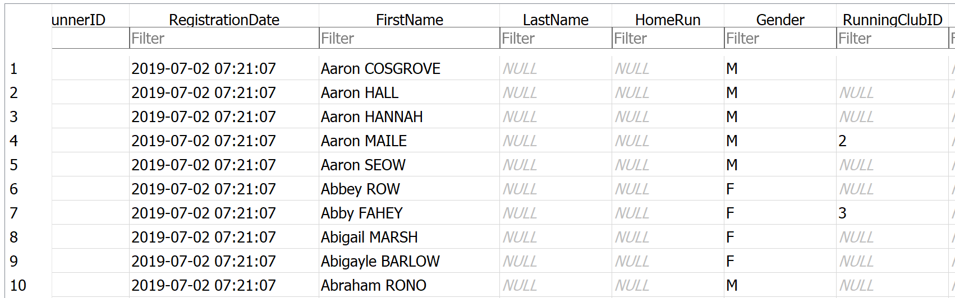
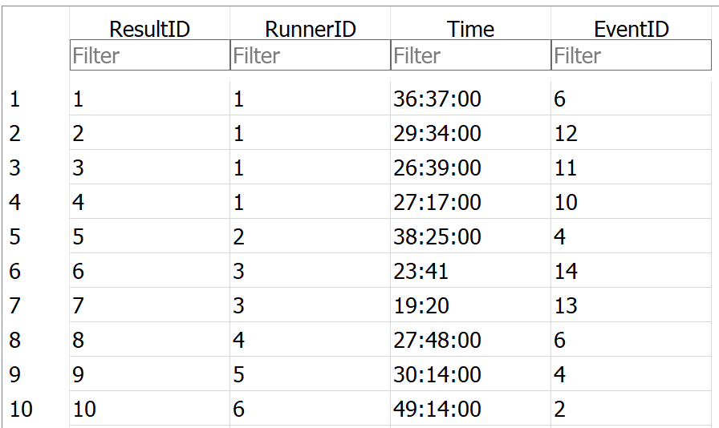
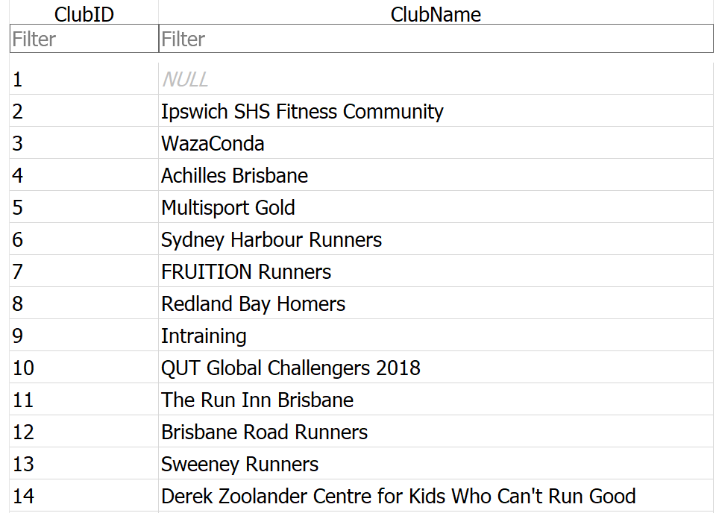



2NF

Slide 37



3NF
All records have met 1NF and 2NF
“Data items have no other dependency other than the primary key”.
Consider the Results table as it appears on Parkrun chapter websites, which fields would fail the 3NF test?

Slide 38
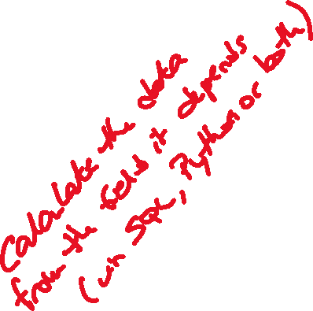
3NF
All records have met 1NF and 2NF
“Data items have no other dependency other than the primary key”.
How would you solve this so that the table passes the 3NF test?

